Slide 1

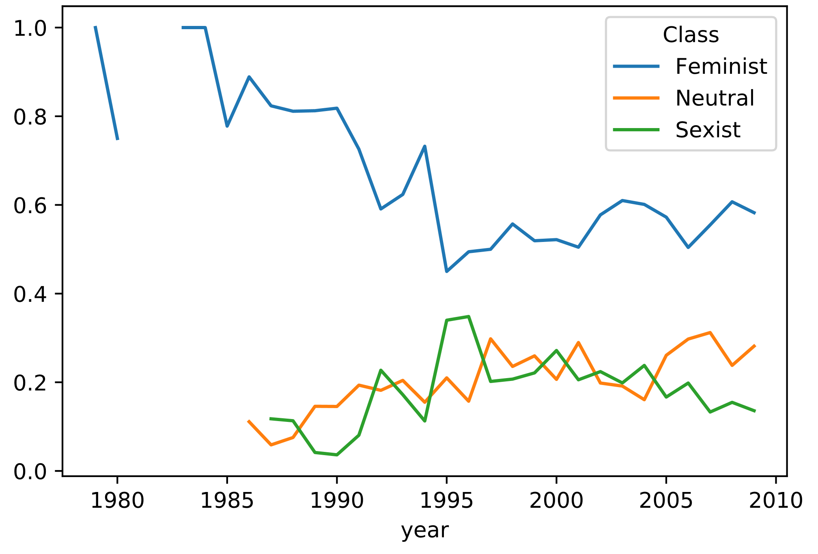
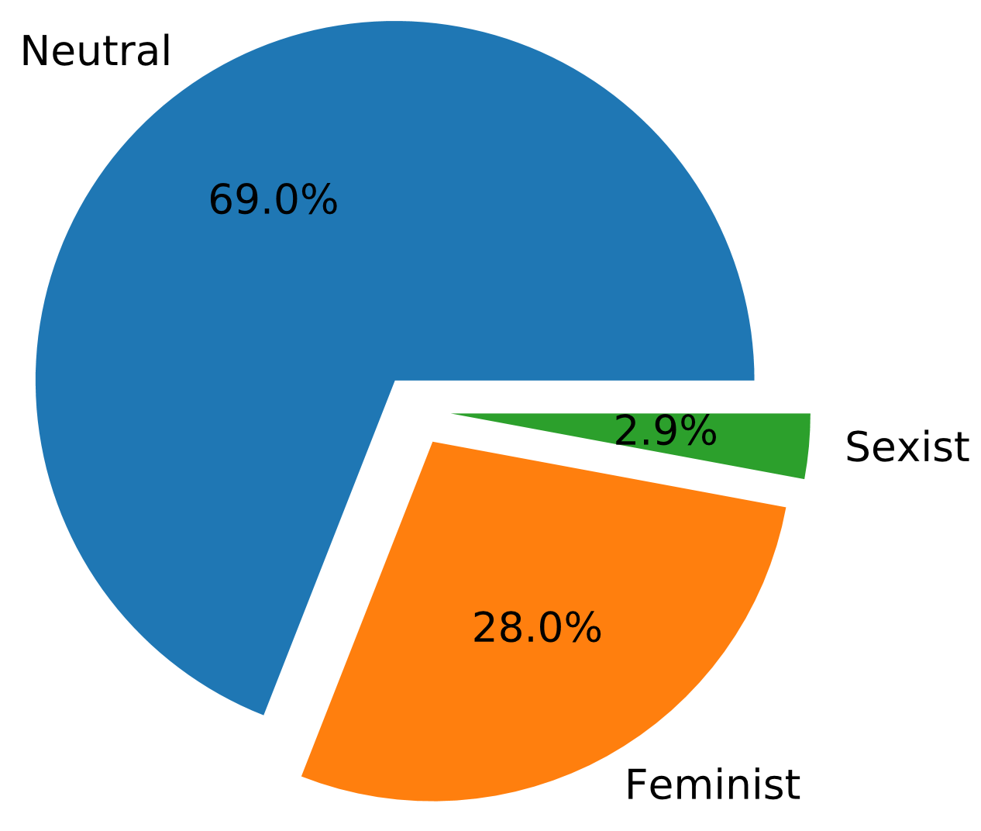
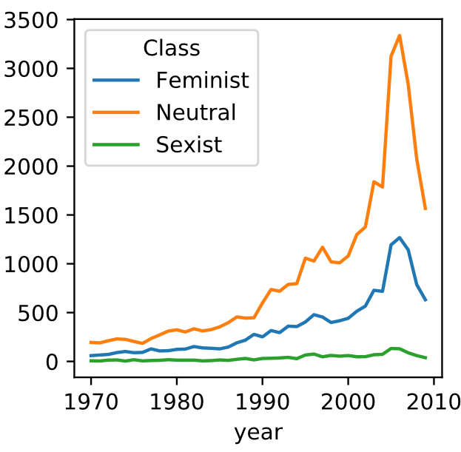
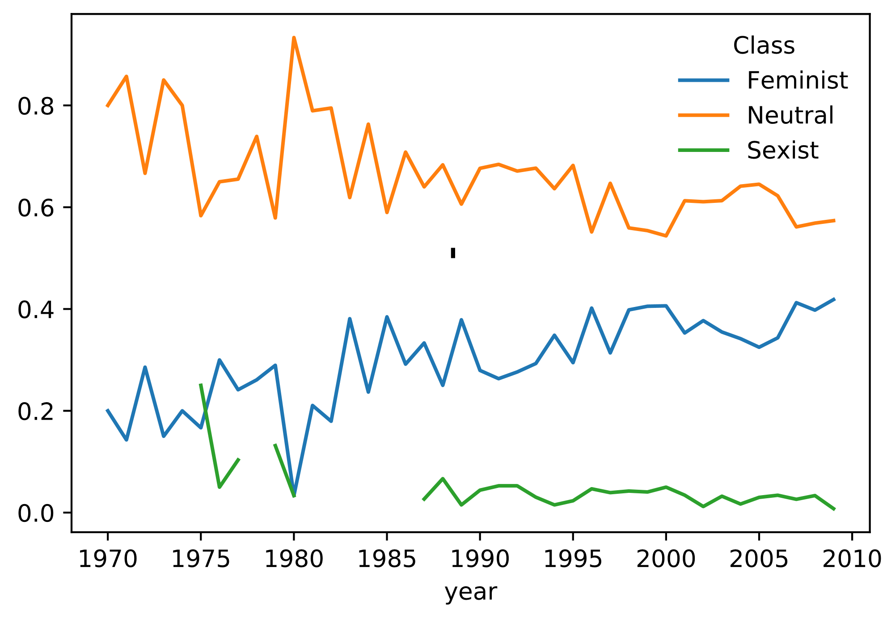
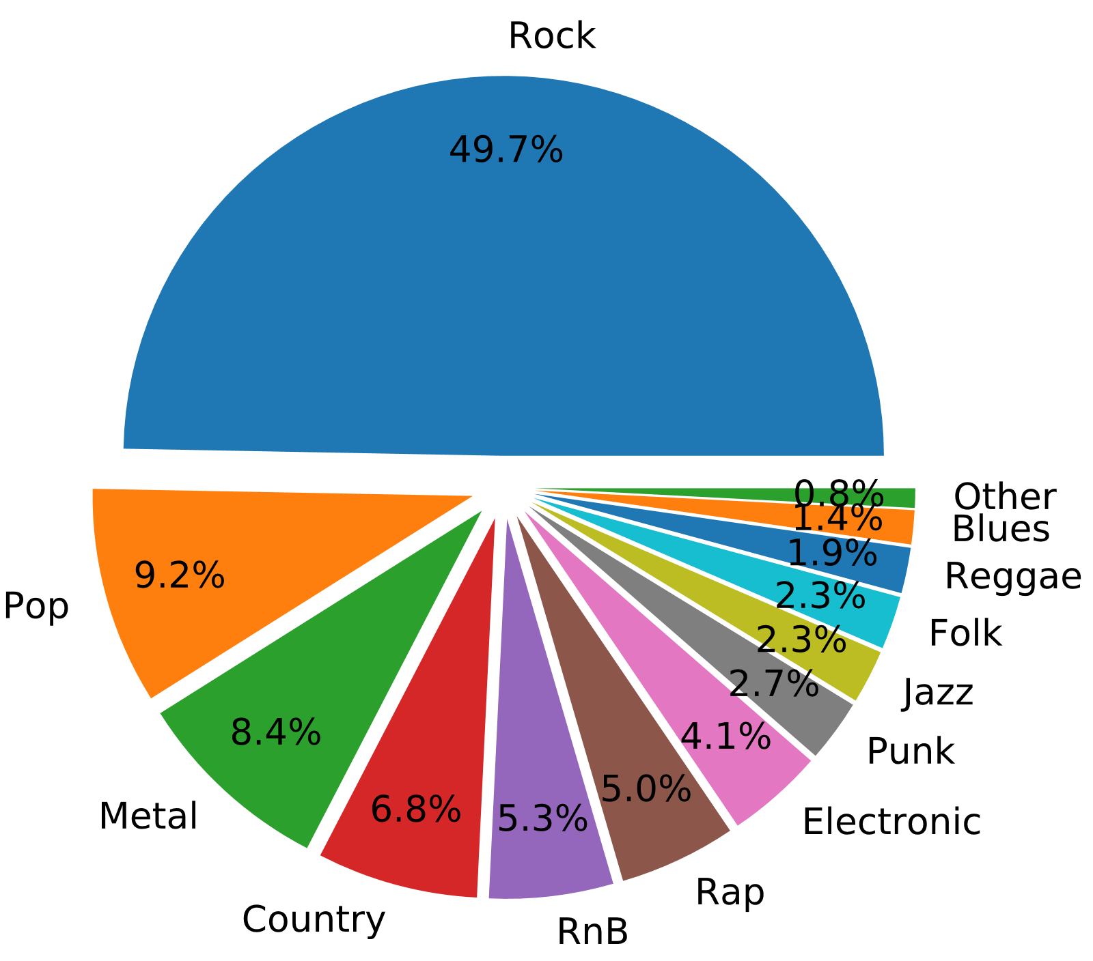
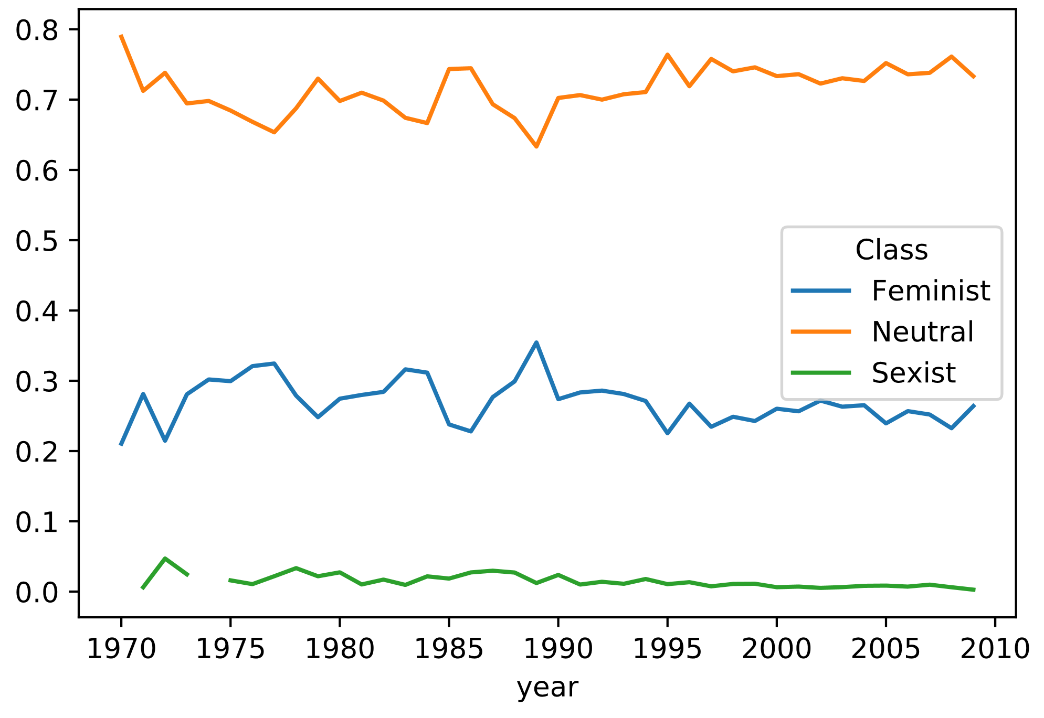
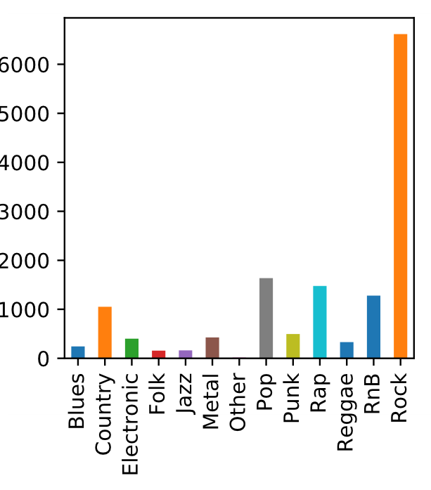
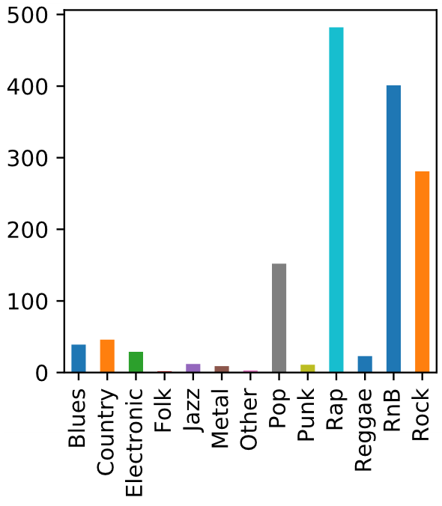
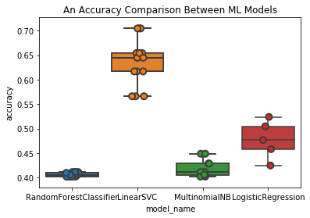
Feminism vs. Sexism in Lyrics:
A Portrait of Women in Recent Music
Slim Kammoun – Arthur Parmentier – Xiaoning Yang
Abstract
The Big Picture
How were women depicted in the 1970s vs. 2000s? Are the images of women different for Rock vs. Rap music? Are there artists that are especially sexist or feminist? We hope to find the answers in the lyrics.
Introduction
Figure 2. Number of songs in each class over time
Ever since the beginning of the 20th century, a number of political and social movements have arisen with the goal of empowering women and pushing for social equality of sexes.
Numerous feminist ideologies have developed over the past half-century and the topic certainly represents different viewpoints and aims which spark heated debates of both praises and criticism. Sexism on the other hand, is much less controversial and refers to any prejudice, stereotyping, or discrimination on the basis of sex, typically against women.
Feminism empowers women, Sexism discriminates against women. The two seemingly opposing dynamics have been explored through various mediums by many aficionados.
In this poster, instead of approaching the topics from the conventional political, societal, or historical perspectives, we decided to look to music, particularly the lyrics of songs published over the last fifty years (or so) to seek insights.
Figure 1. Total repartition
Figure 6. Proportion of feminist, neutral and sexist classified songs as a function on time in rap music
A brief overview of number of feminist, neutral, and sexist songs are displayed in figure 2. We can see clearly here that significantly more data become available during recent years. The fallout in 2008-2009 is due to the incompleteness of the data in that period. It is worth noticing that number of neutral songs and number of feminist songs are both steadily increasing throughout the year, where the number of sexist songs remain relatively constant. This means the proportion of sexist songs produced each year is getting lower.
Pop Music
As the name suggests, Pop Music, or popular music aims to appeal to general audience, as opposed to a particular sub-culture or ideology. Pop Music is progressive, and tends to reflect changes experienced by the society. There is a clear increasing trend in the proportion of feminist music produced each year for this genre.
Genre analysis
Data Acquisition
Figure 7. Proportion of feminist, neutral and sexist classified songs as a function on time in pop music
To later train a model, we chose to acquire lyrics from feminist, neutral and sexist songs. We combined several existing lyrics scrapers to be the lyrics from our feminist, neutral and sexists songs playlists.
Our feminist playlist was built using user-labeled feminists songs found over the internet.
Our neutral playlist was built by ourselves, choosing songs that did not talk about women or in very neutral ways.
Our sexist playlist was built upon user-labeled songs found over the internet.
The set we used our model on was the subset of the songs from the Million Song Dataset that contains title, artist, year and genre metadata for each song (50991 songs).
Rock Music
We can see that Rock music is fairly feminist, having a steady increase of women empowering songs. Although the proportion of the latter varies throughout the years, it does not leave the 20% ~ 30% interval.
Figure 3. Genre repartition over the dataset
Machine Learning Model
Figure 4 & 5. Repartition of feminist and sexist songs over the genres
Figure 8. Proportion of feminist, neutral and sexist classified songs as a function on time in rock music
Rap Music
Conclusions
Rap Music, or Hip Hop music may be known for being passionate, inspirational, expressive, or in today’s linguistics, “lit” or “fire”, it is certainly not known for being respectful to women. Many songs from the sexist playlists we scraped are Rap songs. We hypothesized that this would be the genre with the highest proportion of sexist songs before any analysis is done. Even though the proportion of sexist songs are high in rap music, we see a decrease in percentage over recent years.
Put conclusion here
For later results, we use the Linear SVC model that yields the best accuracy. PUT VECTORIAL IMAGE

